Slide 1
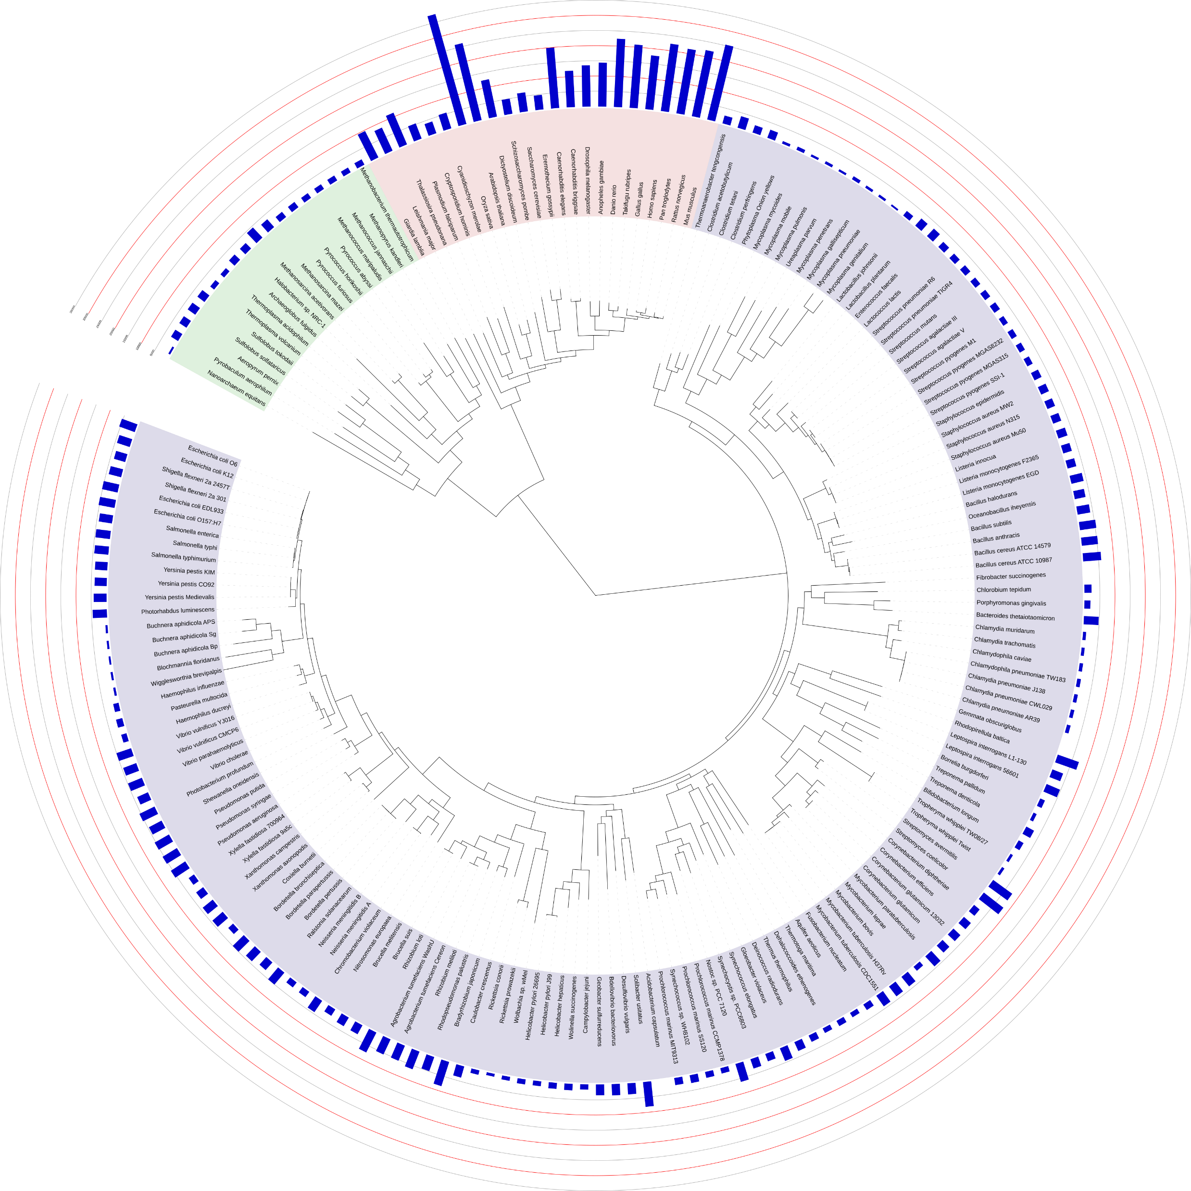
Phylogenomic inference with OrthoFinder and iTOL

Slide 2
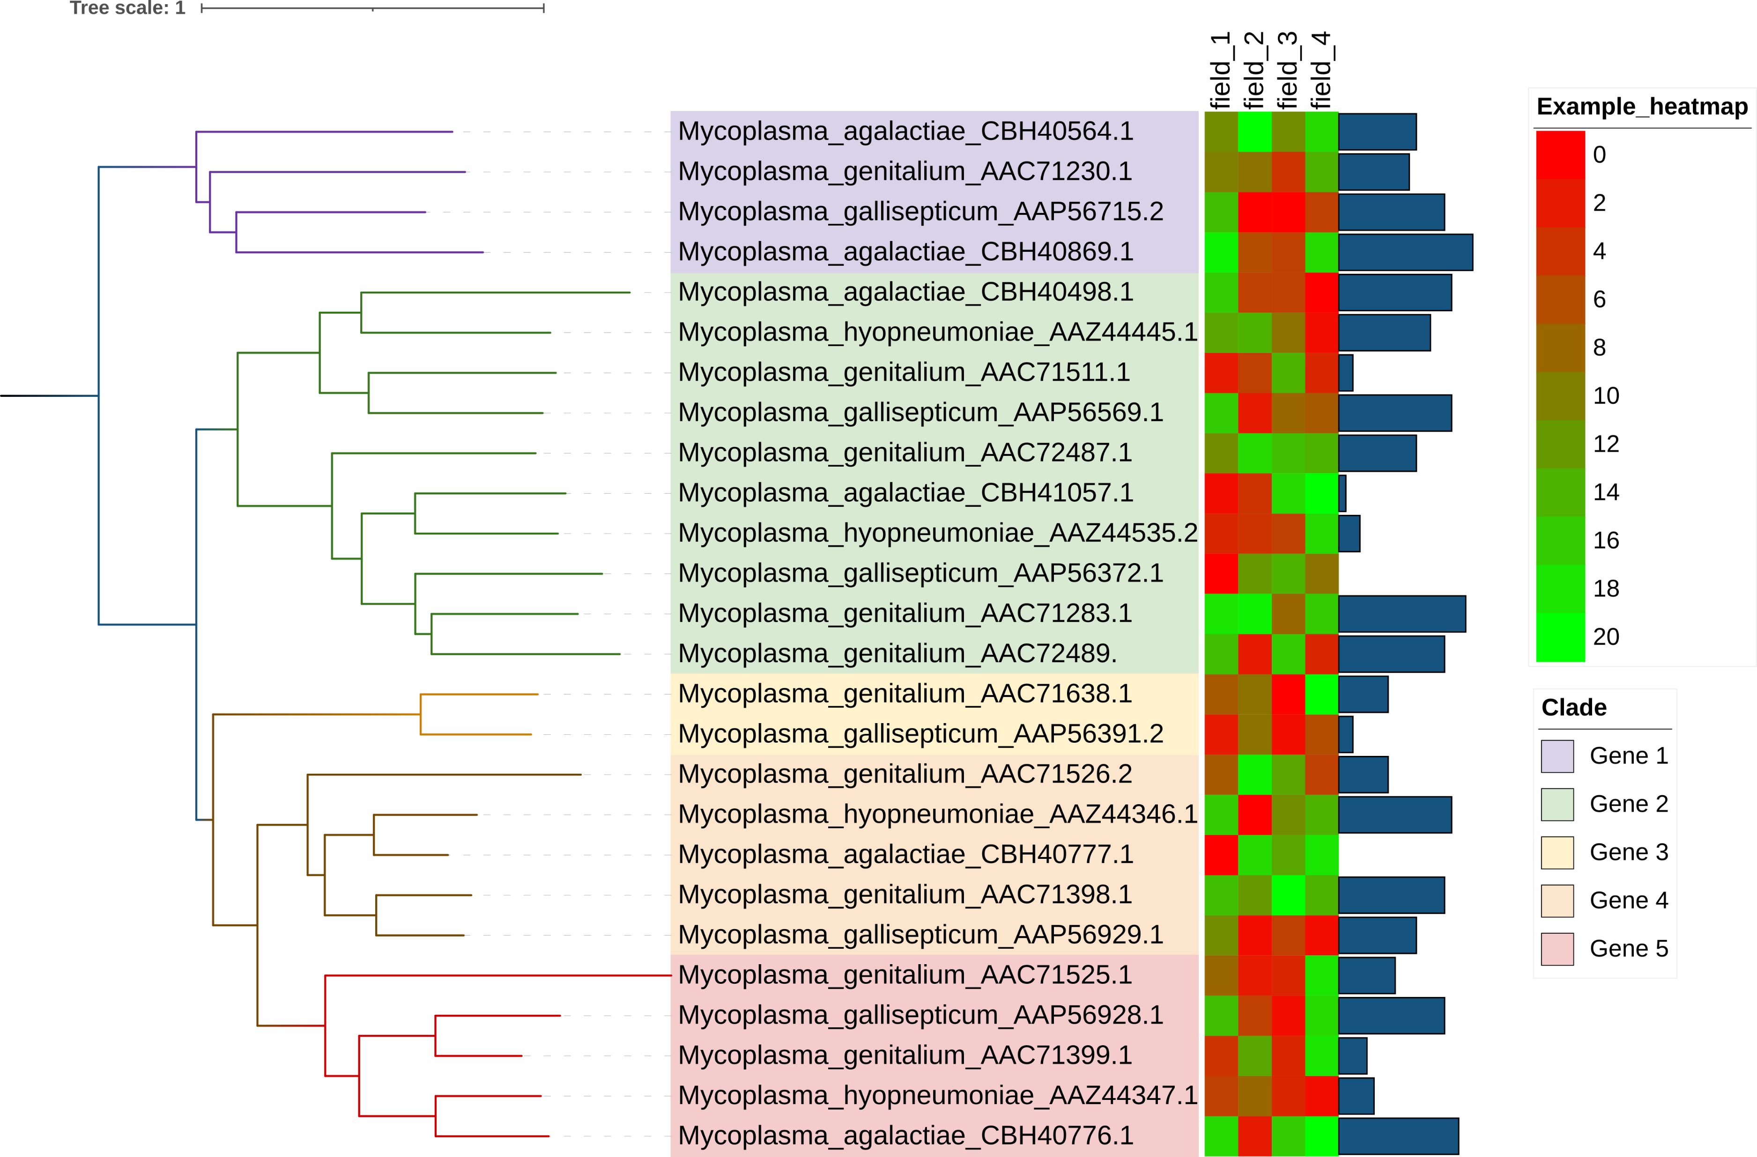
Workshop aims
Introduce phylogeny, gene orthologues, OrthoFinder, and Interactive Tree of Life (iTOL)
Show how to run OrthoFinder, and how phylogeny can be inferred using it for both gene trees and species trees
Show how iTOL can be used to visualise phylogenetic trees
Show how by using the iTOL annotation editor, trees can be annotated with additional data, or altered for clarity
To turn four genomes into this:

Slide 3
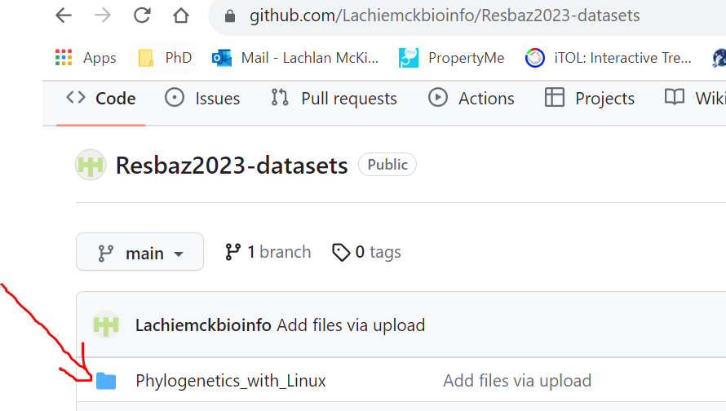
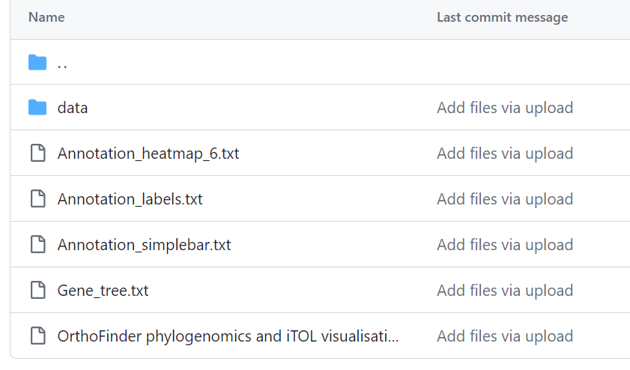
Example data
Example data and results available via GitHib
Pre-made phylogenetic tree (Gene_tree.txt), annotation files for iTOL annotation. Data contains four bacterial genomes for test data
Example data already loaded onto Linux server

Slide 4
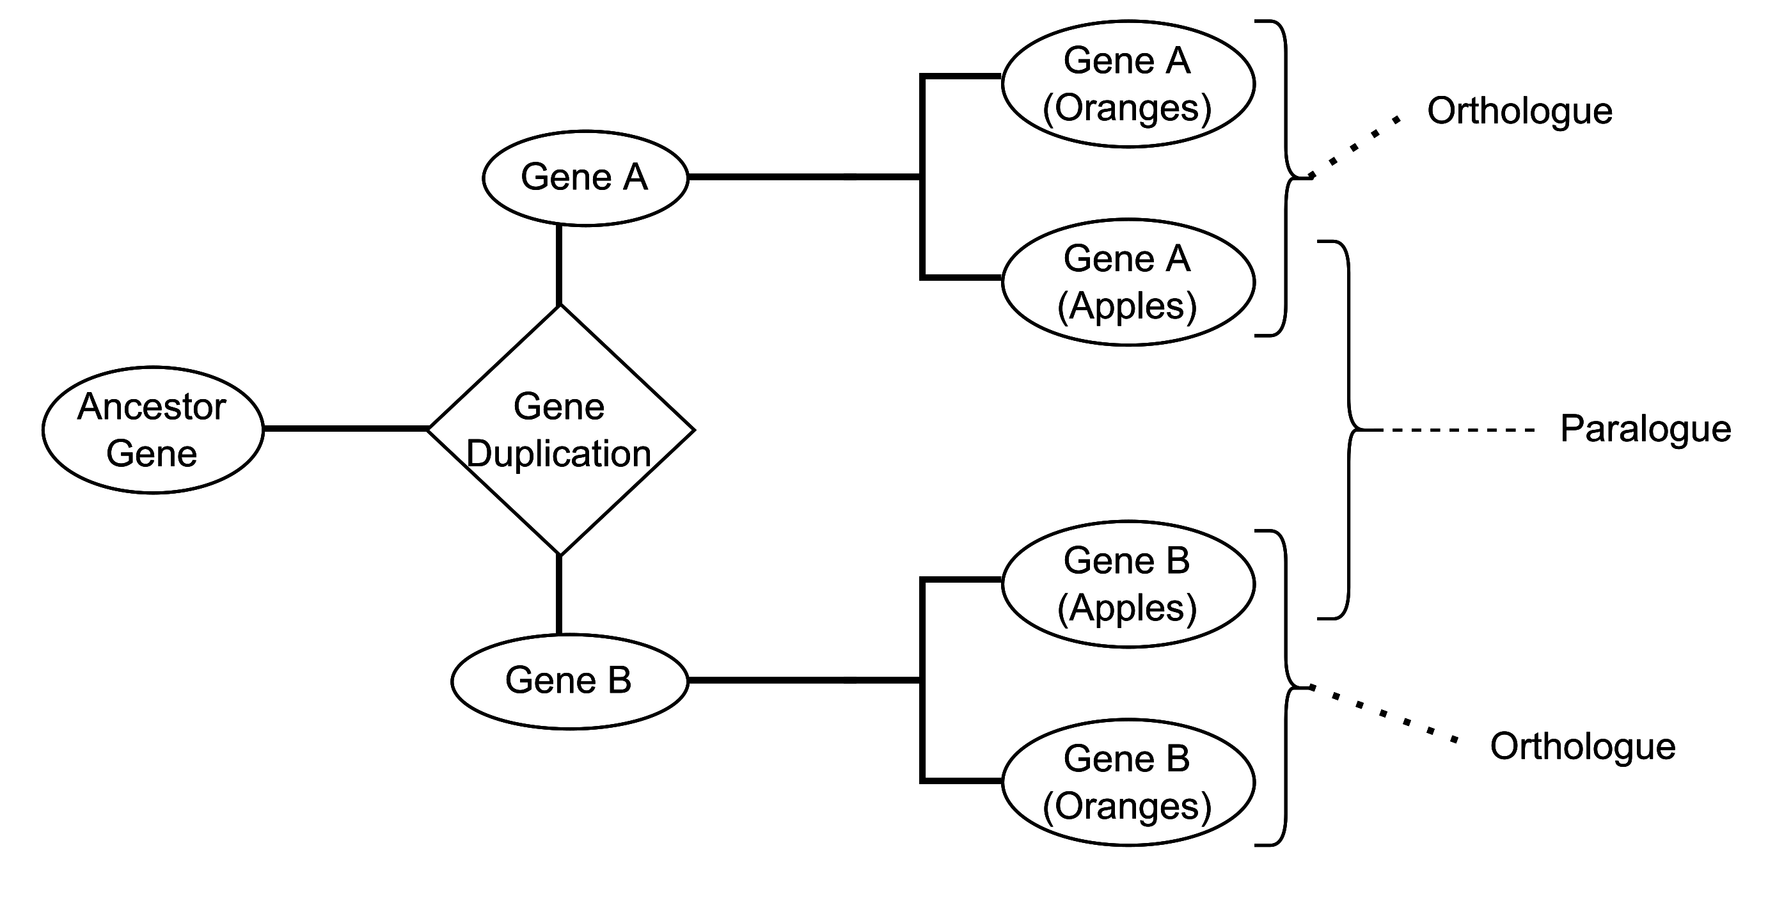
Phylogeny and orthologues
Phylogenetics is the inference of evolutionary relationships using genetic information.
Inferred using orthologues: genes variants between species that have arisen due to speciation (opposed to gene duplication/horizontal gene transfer).
Phylogenetic inference is built on the selection and analysis of orthologues.

Slide 5
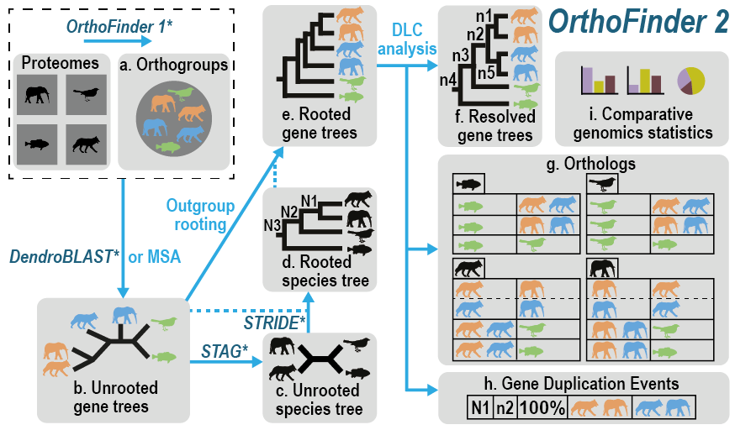
What is OrthoFinder
Gene orthogroup predictor
Linux-based software (also works on Windows and Mac)
Groups genes by identity
Performs gene duplication, phylogenetic analysis
Emms, D.M., Kelly, S. OrthoFinder: phylogenetic orthology inference for comparative genomics. Genome Biol 20, 238 (2019). https://doi.org/10.1186/s13059-019-1832-y

Slide 6
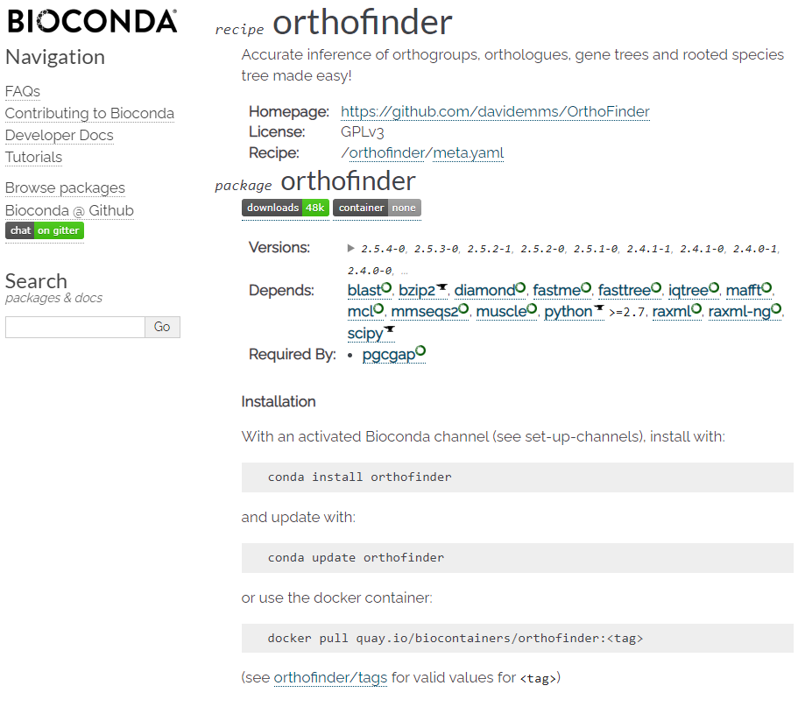
Installing OrthoFinder
Download from Github, requires no installation
Simply unzip
Or download and install via Conda (or other managers)
Activate the channel Bioconda
$conda install orthofinder
Use environments for better installation practices
https://bioconda.github.io/recipes/orthofinder/README.html

Slide 7
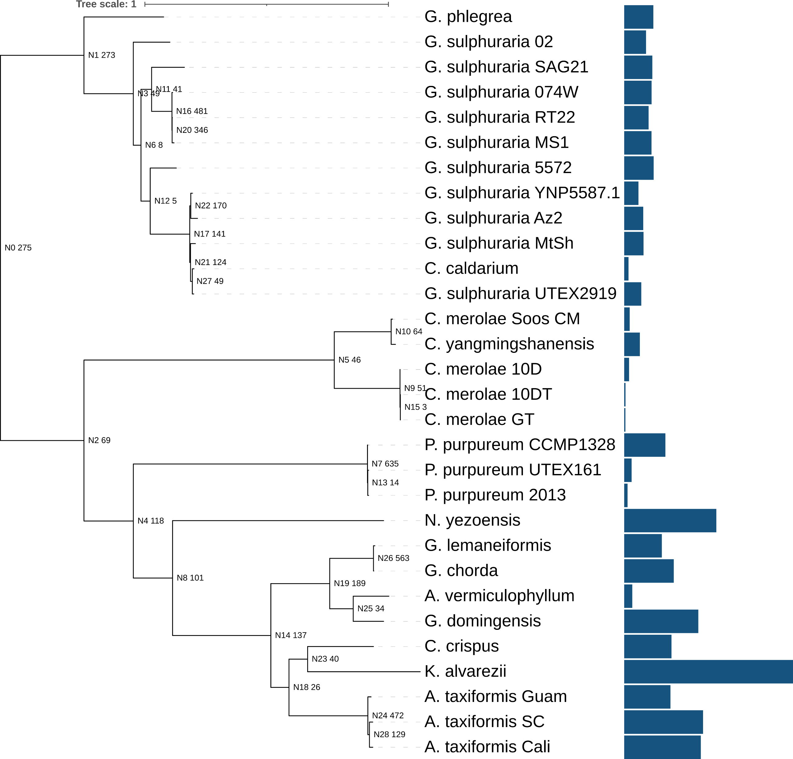
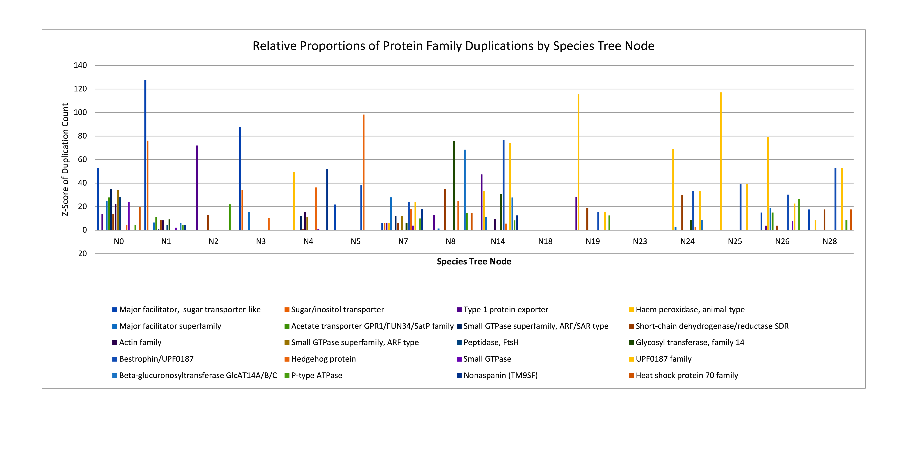
What can we do with it?
Orthogroup 1
Grouping of orthologous genes into “orthogroups”
Detection of gene duplications, linked to species and gene tree nodes
Phylogenetic analysis: both consensus and concatenated species trees
Orthogroup 2

Slide 8
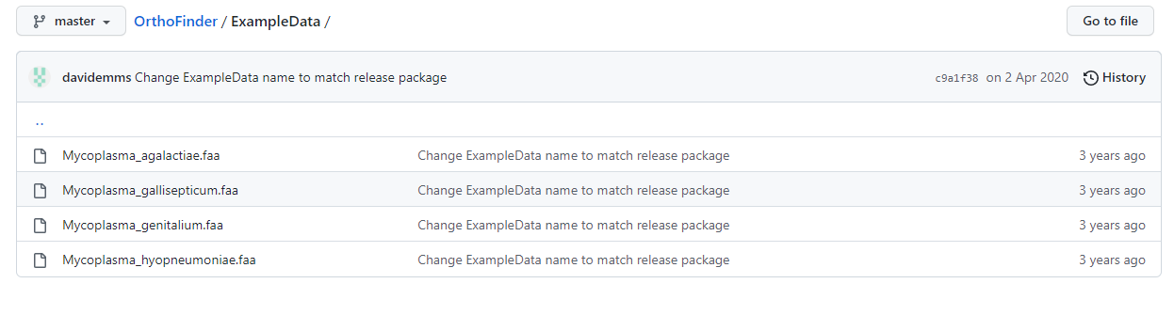
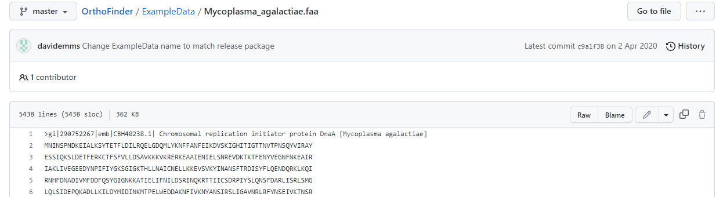
Download example data
https://github.com/davidemms/OrthoFinder/tree/master/ExampleData
Open up each sequence. Select “raw”
Save (“CTRL-S”), will be saved in .txt format
Reformat into .fasta/.fa/faa

Slide 9
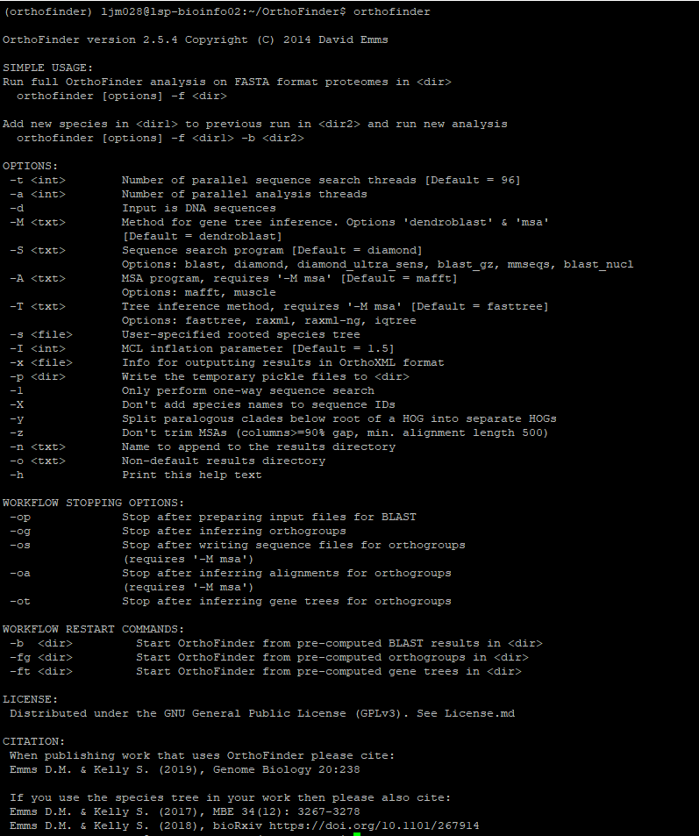
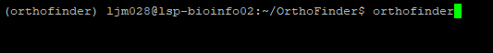
What now?
Try running it!

Slide 10
Useful commands for OrthoFinder
-a/-t: set the number of cores you’ll run the job on
-d: use DNA sequences.
-M: set gene tree inference to either dendroBLAST or multiple sequence alignment (MSA)
-S: Set the search program
-A: MSA program to use (MAFFT or MUSCLE)
-T: Set tree inference method with MSA
-X: Don’t add species name to sequence ID
-b: Add directory from previous run to add to current run

Slide 11
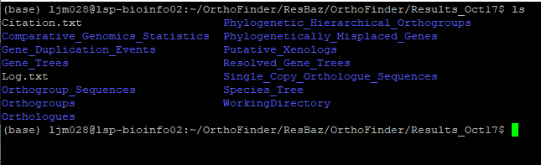
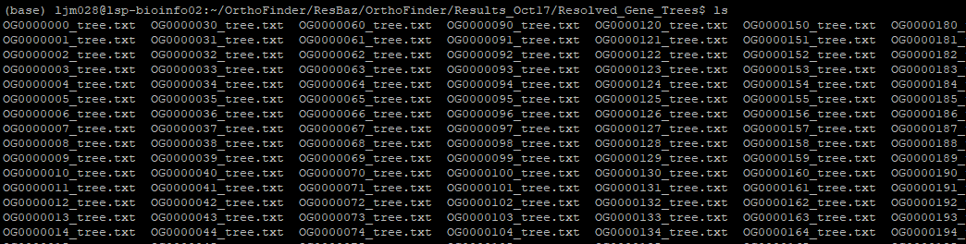
Results
A folder called “OrthoFinder” should be created where you had your data (by default)
Inside there will be the Results_<date> folders
Inside there are the actual results
We will be looking at the Species_Tree and Resolved_Gene_Trees directories
Notes:
What OrthoFinder is doing is calculating groups of orthologs genes, and making gene trees out of them. It then takes a selection of single copy orthogroups (i.e. orthogroups with one copy per individual genome), and makes a species tree by combining them.

Slide 12
Oh no! I forgot a genome!
There’s a few ways to add genomes, but the simple way is to use the -b option.
Make a new directory with new genomes
Use –f to select the new directory, and –b to select the location of the original directory

Slide 13
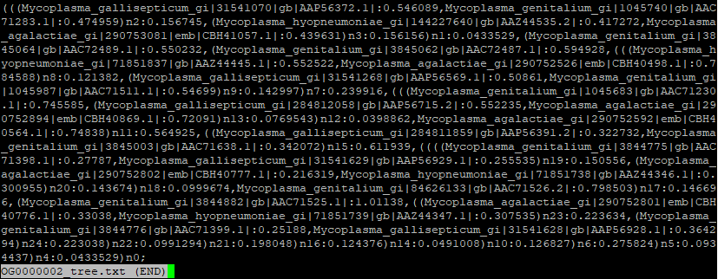
Results
Species tree
Lets grab a tree (either a gene tree or a species tree)
Trees are in Newick format.
Using the example data, the species tree will have only 4 branches, while the gene tree may have many
Now lets visualise these with iTOL!
Gene tree

Slide 14
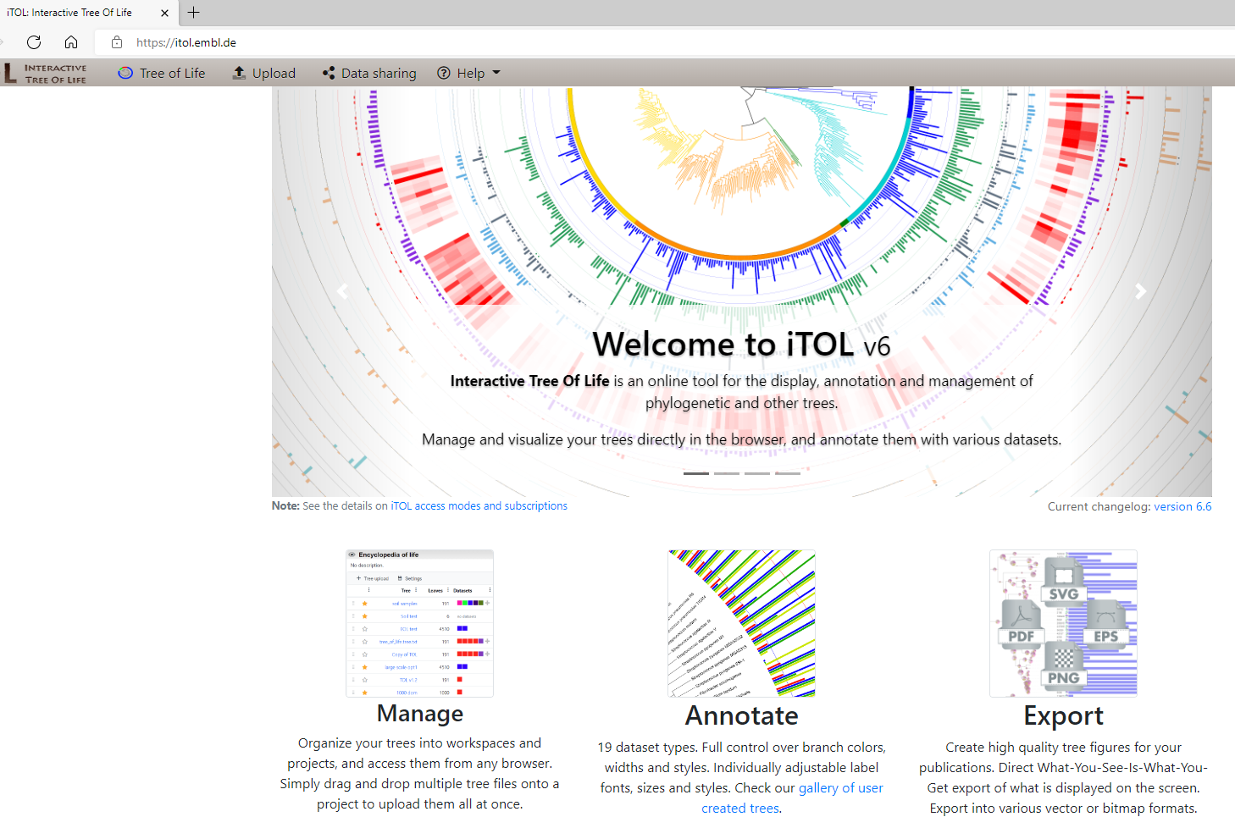
iTOL
Allows for easy generation of phylogenetic trees
Can annotate online, or using annotation files
Free, but must buy premium version to save edited trees
Accepts Newick, Nexus, PhyloXML, and Jplace tree formats
https://itol.embl.de/

Slide 15
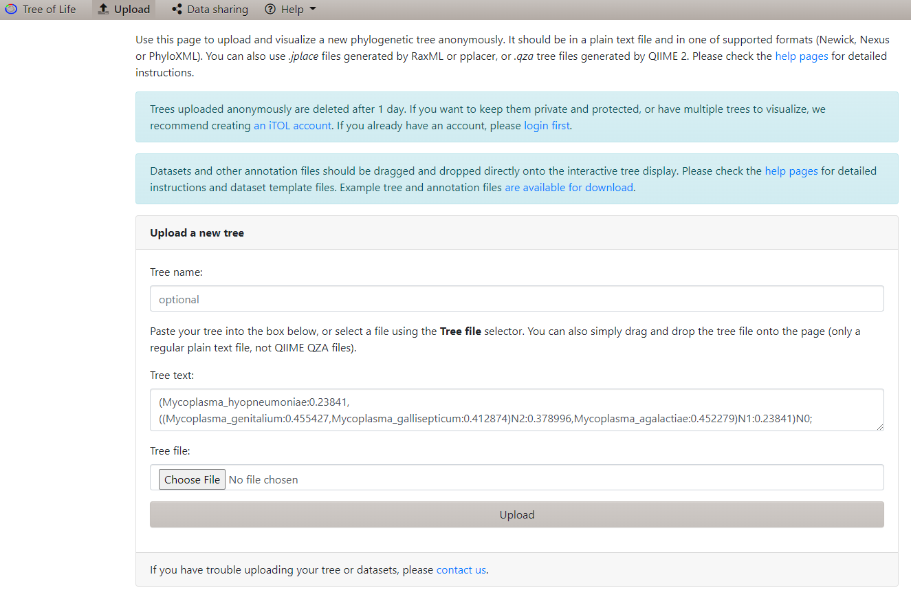
iTOL Demonstration

Slide 16
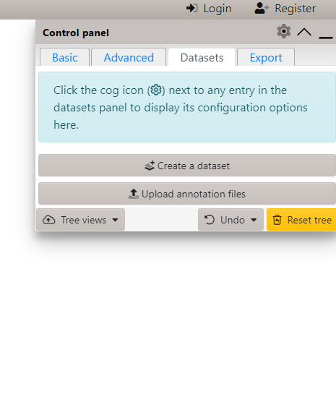
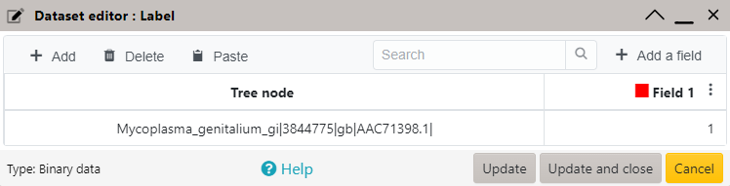
iTOL: Datasets
Annotation file templates can be downloaded here: https://itol.embl.de/help.cgi#annoTemplate
Notes:
Note that when adding annotations to a branch, you must use the name in the tree file or text, NOT the label shown on the tree image. Even if you change the label name, you must use the original name.

Slide 17
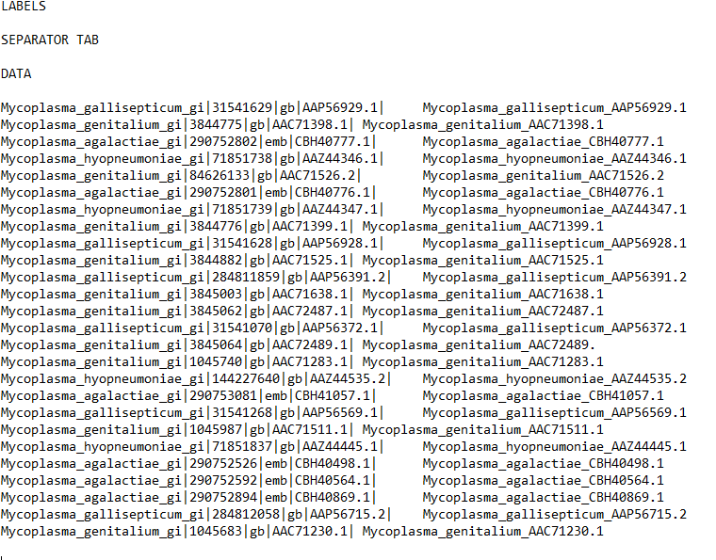
Changing names
1
2
3
5
Annotation type
Separator
Data start
Old names
New names
4

Slide 18
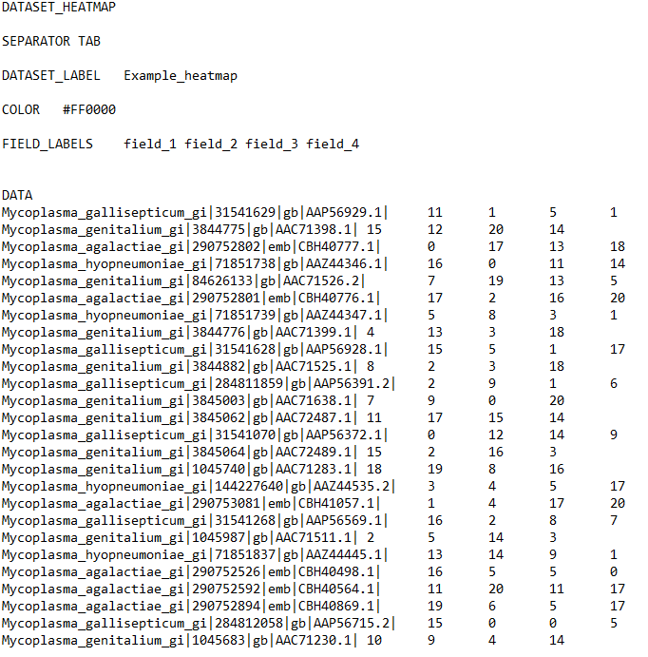
iTOL: Datasets
1
2
3
4
5
Annotations can be added using text files.
For an example, lets make a heat map.
There are six required fields for heatmaps:
Dataset type
Delimiter
Dataset label
Colour
Field labels
Data
6

Slide 19
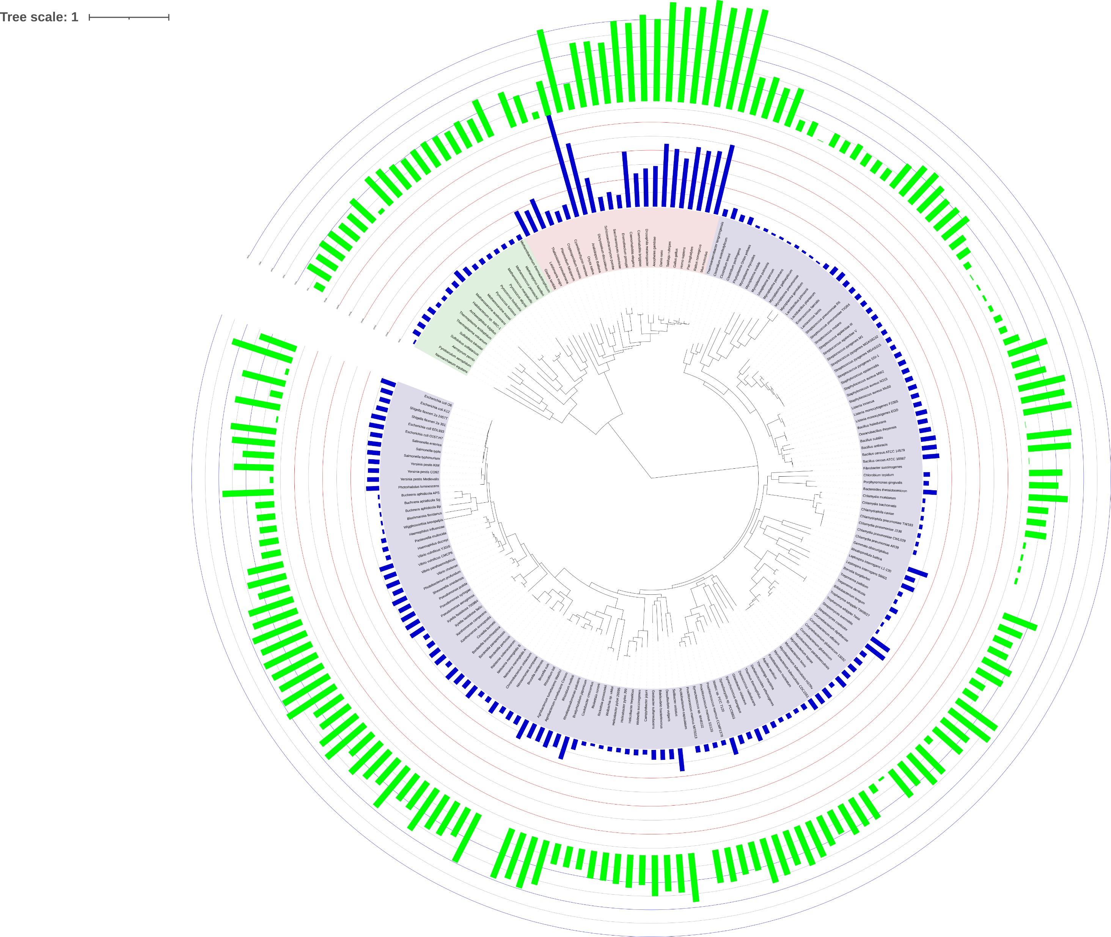
iTOL Tree of Life with annotations
Letunic and Bork (2021) Nucleic Acids Res doi: 10.1093/nar/gkab301

Slide 20
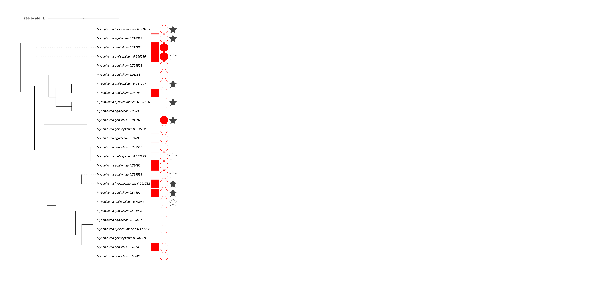
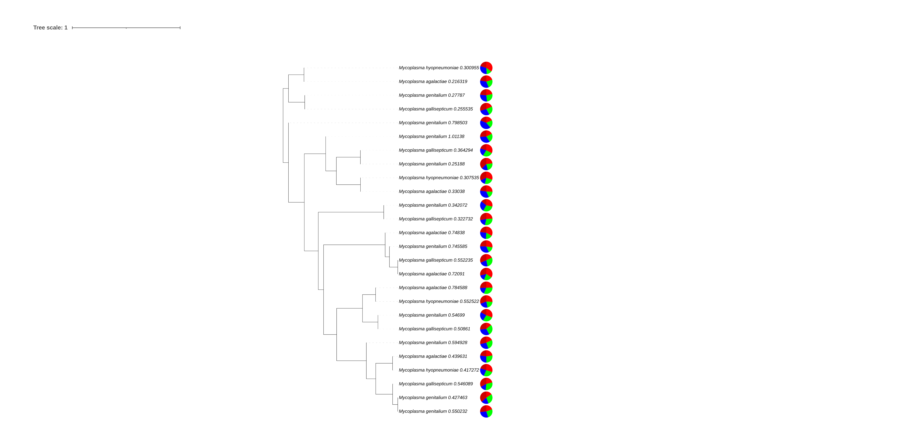

Slide 21
